Slide 1
Capstone project- The battle of neighbourhoods
- By Sai Vignesh Reddy Cholleti

Slide 2
1. Introduction/Business problem:
Background: Safety is a top concern when moving to a new area. If you don’t feel safe in your own home, you’re not going to be able to enjoy living there.
Problem: This project aims to select the safest borough in New York City (NYC) based on total crimes, explore the neighbourhood of that borough to find the 10 most common venues in each neighbourhood and finally cluster the neighbourhoods using k-means clustering.
Target Audience: Expats who are considering to relocate to NYC will be interested to identify the safest borough in NYC and explore its neighbourhoods and common venues around each neighbourhood.

Slide 3
2. Data Acquisition and Cleaning:
Data Acquisition: The data acquired for this project is a combination of data from three sources:
The first data source of the project uses a New York City crime data that shows the complaints registered by police department.
The second source of data is scraped from a Wikipedia page that contains the Boroughs of New York City. This page contains additional information about the boroughs.
The third data source is the list of neighbourhoods in each borough which is taken from coursera previous lab session.

Slide 4
Data Cleaning: The data cleaning process for each of the three sources of data are done separately.
From the NYC crime data, the crimes during the most recent year (2015) are only selected. The major categories of crime are pivoted to get the total crimes per boroughs for each major category.
The second data is scraped from a Wikipedia page using the BeautifulSoup library in python. Using this library we can extract the data in the tabular form as shown in the website.
The two data sets are merged on the Borough names to form a new data set. The purpose of this data set is to visualize the crime rates in each borough and identify the borough with the least crimes recorded during the year 2015.
After visualizing the crime in each borough we can find the borough with lowest crime rate. The third data set is created, with the names of the neighbourhoods and the name of the borough with the latitude and longitude obtained using python geocoder.
The new data set is used to generate the 10 most common venues for each neighbourhood using the Foursquare API, finally using k-means clustering algorithm to cluster similar neighbourhoods together.

Slide 5
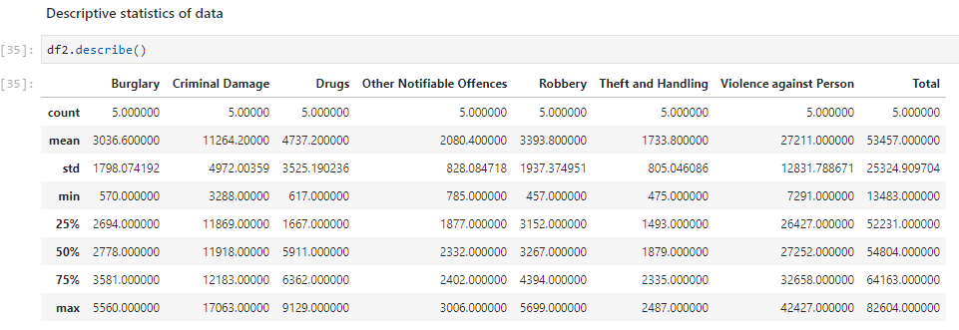
3. Methodology:
Exploratory Data Analysis
The count for each of the major categories of crime returns the value 5 which is the number of NYC boroughs. ‘Violence against Person’ is the highest reported crime during the year 2015 followed by ‘Criminal Damage’, ‘Robbery’. The lowest recorded crimes are ‘Theft and Handling’, ‘Other Notifiable Offences’ and ‘Burglary’.

Slide 6
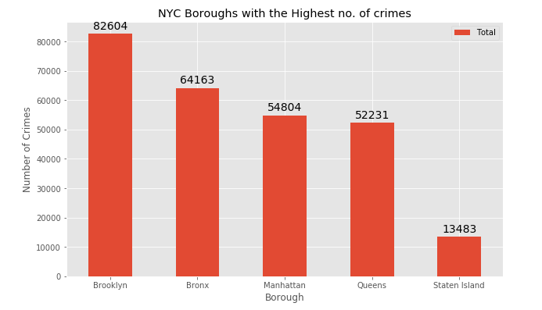
Boroughs with the highest crime rates
Comparing five boroughs with the highest crime rates during the year 2015, it is evident that Brooklyn has the highest crimes recorded followed by Bronx, Manhattan, Queens and Staten Island. Staten Island has a significantly least crime rate than the other 4 boroughs.
Therefore, Staten Island which has least crime rate is selected for clustering process.

Slide 7
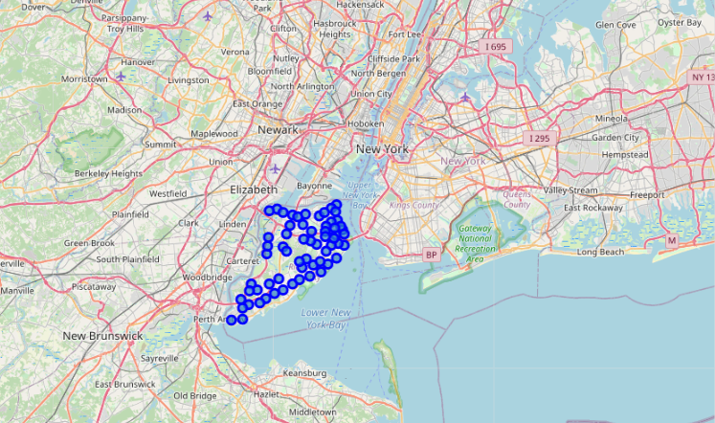
Neighbourhoods in Staten Island
There are 63 neighbourhoods in the borough of Staten Island. They are visualized on a map using folium on python.

Slide 8
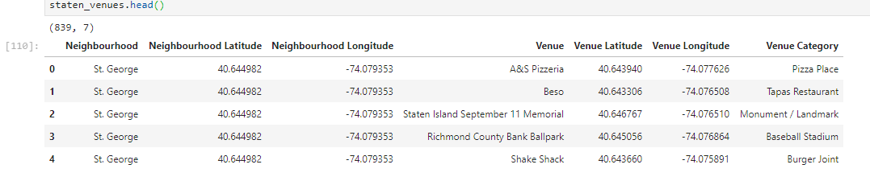
Modelling:
Using the final data set containing the neighbourhoos in Staten Island along with latitude and longitude, we can find all the venues within a 500 meter radius of each neighbourhood by connecting to the Foursquare API
One hot encoding is done on the venues data. The venues data is then grouped by the neighbourhood and the mean of the venues are calculated, finally the 10 common venues are calculated for each of the neighbourhoods.
To help people find similar neighbourhoods in the safest borough, we will be clustering similar neighbourhoods using k-means clustering which is a form of unsupervised machine learning algorithm that clusters based on predefined cluster size.
We will use a cluster size of 3 for this prokect that will cluster the 63 neighbourhoods into 3 clusters. The reason to conduct a k-means clustering is to cluster neighbourhoods with similar venues together so that people can shortlist the area of their interest based on the venues/amentities around each neighbourhood.

Slide 9
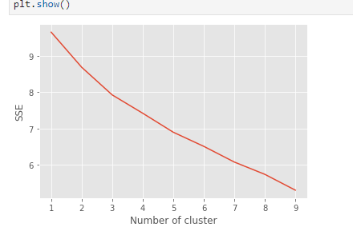
Elbow Method:
A fundamental step for any unsupervised algorithm is to determine the optimal number of clusters into which the data may be clustered. The Elbow Method is one of the most popular methods to determine this optimal value of k.
Elbow method for optimal k value
To determine the optimal number of clusters, we have to select the value of k at the “elbow” i.e the point after which the distortion/inertia start decreasing in a linear fashion. Thus for the given data, we conclude that the optimal number of clusters for the data is 3.

Slide 10
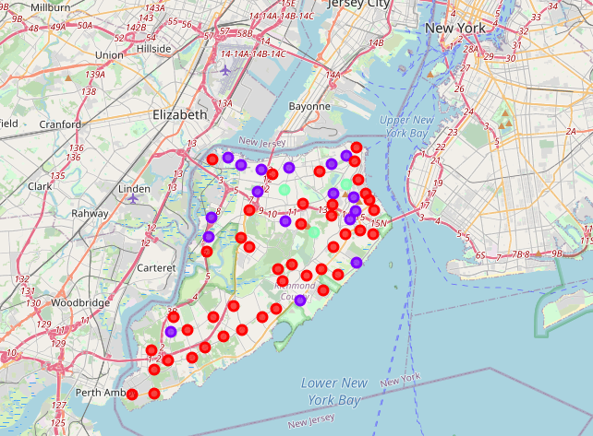
4. Results:
After running the k-means clustering we can access each cluster created to see which neighbourhoods were assigned to each of the three clusters. Visualizing the clustered neighbourhoods on a map using folium library.
Each cluster is color coded for the ease of presentation, we can see that majority of the neighbourhood falls in the red cluster which is the first cluster. Three neighbourhoods have their own cluster (Green), and Other cluster which is blue colored is second cluster.

Slide 11
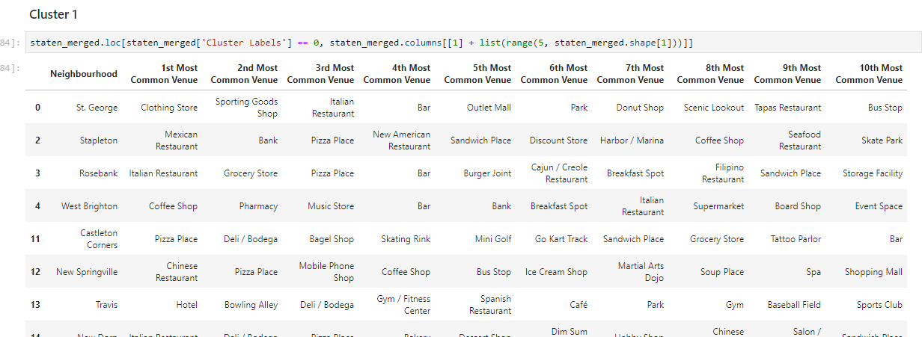
Cluster 1: Looking into the neighbourhoods in the first cluster
The cluster one is the biggest cluster with most of the neighbourhoods in the borough Staten Island. Upon closely examining these neighbourhoods, we can see that the most common venues in these neighbourhoods are Restaurants, Pizza places, Cafe, Supermarkets, and stores etc.

Slide 12
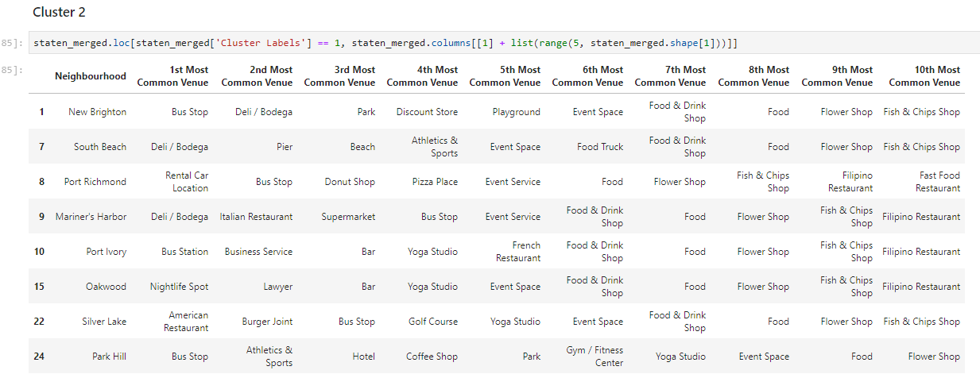
Cluster 2: Looking into the neighbourhoods in the second cluster
The second cluster has some neighborhoods which consists of venues such as Bus stops, Deli/Bodega, and Restaurants.

Slide 13
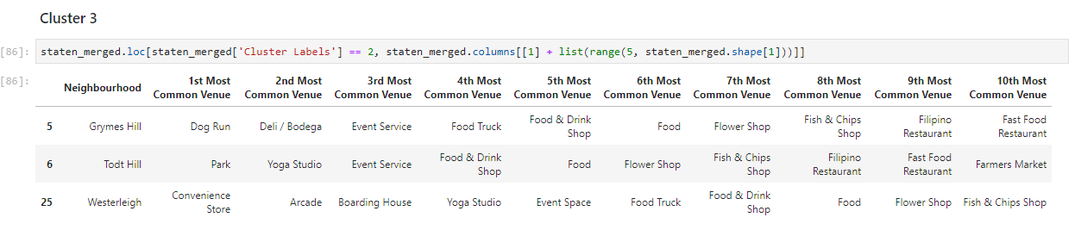
Cluster 3: Looking into the neighbourhoods in the third cluster
The third cluster is the smallest cluster with only three neighborhoods which consists of venues such as Dog Run, Park, and Convenience store.

Slide 14
5. Discussions:
The aim of this project is to help people who want to relocate to the safest borough in New York City, expats can chose the neighbourhoods to which they want to relocate based on the most common venues in it.
For example if a person is looking for a neighbourhood with good connectivity and public transportation we can see that Clusters 2 have Train stations and Bus stops as the most common venues.
If a person is looking for a neighbourhood with stores and restaurants in a close proximity then the neighbourhoods in the first cluster is suitable.
For a person who enjoys nature, I feel that the neighbourhoods in Cluster 3 are more suitable dues to the common venues in that cluster, these neighbourhoods have common venues such as Dog Run, Park, and Convenience store. Cluster 1 being biggest cluster with most number of neighbourhoods and variety of venues in each neighbourhood, is ideal for any kind of person. The choices of neighbourhoods may vary from person to person.

Slide 15
6. Conclusion:
This project helps a person get a better understanding of the neighbourhoods with respect to the most common venues in that neighbourhood. It is always helpful to make use of technology to stay one step ahead i.e. finding out more about places before moving into a neighbourhood.
We have just taken safety as a primary concern to shortlist the safest borough of New York City. The future of this project includes taking other factors such as cost of living in the areas into consideration to shortlist the borough, such as filtering areas based on a predefined budget.

